Slide 1

#chal-alu-lea
SAP – C4V
2019-April-Hackathon

Slide 2
About the team …
WHO WE ARE?
Anna Oliveira
Pedro Accorsi
Bruno Eltz
Jonatas Silveira
David Reis
Priscila Ludwing
Vanessa Martinez
Edgar Fernandez
WHERE ARE WE FROM?
We all work at SAP WHERE DO WE PARTICIPATE FROM?
Most of us are from Rio Grande do Sul, Brazil and we also have two Venezuelan teammates

Slide 3
About the project …
Why did we choose this challenge?
We selected this challenge because:
We wanted to help motivate and encourage people to increase the donations of the USB based on Gamification methodology

Slide 4
About the solution …
What did we do to solve it?
Our approach was:
A new php page was created which displays the leaderboards along the page. In the top stays the general ones and the campaign’s ones right below. The buttons open a new tab with the current info and donation page of the respective campaign. All the leaderboards are generated from SQL queries based on the .csv files given. Furthermore, we updated each campaign image in order to attract the donator's attention.
Assumptions in Databases:
New Boolean field Anonymous added in order to recognize and discard these entries when processing the leaderboards.
New Campaign field added in order to group the campaigns and display it separately. It would be appropriate to create a new table containing the campaigns’ information, if does not exist yet.

Slide 5
About the current state …
Where are we?
We accomplished:
Leaderboards created:
Top 5 donators per campaign
Top 5 donators per country
Top 5 donators general
Total amount and number of donations per campaign
Next Steps:
Thinking of ways for sharing the donation to promote the campaign through different social medias such as Instagram, Facebook, Twitter.
The main idea will be to create an automatic email that every donor will receive after the donations submission. The email template will thanks the donor and contain the three options to share the news with friends. (Templates attached in github)

Slide 6
Print Screen Demo

Slide 7
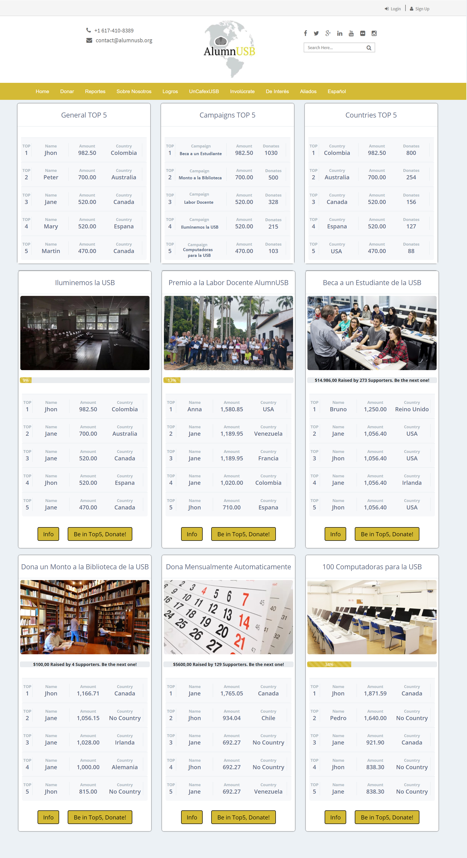

Slide 8
Devpost:
https://devpost.com/software/c4v-alu-lea
Slack channel:
#c4v-sjiy
Where to find us

